Slide 1
Business Services –
Purchasing Refresher
Business Services supports the fiscal operations of the college by providing comprehensive accounting, purchasing, disbursement, and financial reporting support and services to students, faculty, staff, and third parties.

Slide 2
Business Services – Leadership
Sabrina Houck– Director, Business Services
Rebecca Wheeler– Assoc. Director, Business Office Operations
Katie Ventura – Controller
Student Finance and Accounting -Staff
Lisa Mirante– Student Accounts
Nancy Cisneros-Accounting
Kathleen Hawkins-Accounts Receivable
Brittney Neff- Accounts Receivable
Brenna Crotto– Front Desk Support/Cashier
Julia Alvarez– Cashier
Kiana Townsend– Cashier
Yoshimi “Rika” Van Norman- Whidbey Island Campus Cashier, Purchase Requisition Creation, Military Invoicing, Receiving

Slide 3
Purchasing and Payables – Staff
Teresa Miller – Purchasing (P-Cards, IT Related, Travel Purchases)
Danielle Hinds-Purchasing (PO Creation, Contract Verification, Grant Purchasing)
Virginia (Ginny) Tapia-Purchasing (PO Creation, P-Cards, Supplier Engagement)
Garrett Dahl- (PO Creation, Bid/Quote/Sole Source Acquisition Support)
Miranda Brown – Accounts Payable (A-I Vendors, Travel, Assets)
Douglas Scheel– Accounts Payable (J-Q Vendors)
Shirley Confer – Accounts Payable (R-Z Vendors)

Slide 4
Procurement Process Flowchart
As a function of Business Services, Purchasing provides procurement services for the College by facilitating the receipt of all goods and services in a timely and economical manner.
Purchase Requisition
Purchase Order
Receipt of Goods
Supplier Invoice
Payment

Slide 5
Purchase Requisitions –
The purchase requisition is the “request” to purchase. The requisition is created in ctcLink, as a document to seek permission to purchase the goods and services necessary for the program or department. The requisition is submitted for Budget Manager approval.
Purchase Requisitions (PR) is a Request to Purchase, these are entered by the requestor and submitted for Budget Manager Approval to purchase.
  The PR outlines the goods or services needed by the program or department
  Includes the supplier, budget(s) being charged, quotes, and other details
  Approval flow is based on the budget used, total price, and account coding
SBCTC has determined three general types of Purchase Requisitions that can be entered, This is up to the Department and is based upon what is being requested for purchase:
  The Detailed One-Time Requisition
  The “Open PO” Requisition
  The Simple One-Time Requisition

Slide 6

Purchase Requisitions -
Detailed One-Time
This requisition type
  When naming a detailed one-time requisition, please use the following: Vendor, Department, Brief Description
  Please Note: If the purchase should be made with a credit card, that information should be added to the naming convention, Vendor, (Visa or Credit Card #), Dept, Description
  PR Includes a line for each item or service the department would like to purchase
  PR provides a high degree of detail for reporting and receiving purposes
  Please note in the comments whether you will be placing the order or if it should be done by the Purchasing staff. The comments should include any quotes, contracts or documentation that provides information about the request to purchase.
The requestor is currently responsible for processing the requisition.
  If you need to attach additional documents after the requisition has been submitted, please email them to purchasing@Skagit.edu with your Requisition number. The Purchasing staff can attach them when the PO is created.

Slide 7
Purchase Requisitions
“Requisition to Create Open PO”
These requisitions are best used for frequent, recurring purchases from a specific supplier, for example; Lowe’s, Office Depot, Verizon, etc.
  The PR should include one line for the gross estimated amount that you would like to spend
  When naming a detailed one-time requisition, please use the following: Vendor, Open Department, Brief Description
  Please Note: If the purchase should be made with a credit card, the information should be added to the naming convention, Vendor, Open, Visa, Dept
  Purchases will go against the total until you’ve spent the gross amount
  Please note in the comments whether you will be placing the order and sharing the purchase order with the supplier or if it should be done by the Purchasing staff. The comments should Include any quotes, contracts or documentation that provides information about the request to purchase
The requestor is currently responsible for processing the requisition.
  If you need to attach additional documents after the requisition has been submitted, please email them to purchasing@Skagit.edu with your Requisition number. The Purchasing staff can attach them when the PO is created.

Slide 8
Purchase Requisitions
Simple One-Time
These requisitions are best used for many items being charged to the same expense Account Code, for example; furniture orders.
  When naming a detailed one-time requisition, please use the following: Vendor, Department, Brief Description
  Please Note: If the purchase should be made with a credit card, the information should be added to the naming convention, Vendor, (Visa or Credit Card #), Dept, Description
  PR includes a single line-item with the gross amount of your purchase
  Please note in the comments whether you will be placing the order or if it should be done by the Purchasing staff. The comments should include any quotes, contracts or documentation that provides information about the request to purchase
The requestor is currently responsible for processing the requisition.
  If you need to attach additional documents after the requisition has been submitted, please email them to purchasing@Skagit.edu with your Requisition number. The staff can attach them when the PO is created.

Slide 9
Purchase Orders-
The purchase order is the document that is created to initiate/make the purchase. The State of Washington views the Purchase Order as a form of a contract between the College and the Supplier.
A Purchase Order (PO) is created only by Purchasing staff
  The PO is sourced from a Purchase Requisition (PR), created by each department
  Minimizes duplication and data entry errors
Purchasing staff will review the requisitions and work with Departments to ensure the compliance with College policies and procedures in accordance with OFM guidelines and the State RCW’s.
Once a PO is created, Purchasing staff will dispatch it. (Make it available)
  The requestor and vendor should both receive the PO.
  If a purchase order needs to be changed for any reason, please email the details to purchasing@Skagit.edu
  Any change order(s) created will go back through the approval workflow for Budget Manager Approval

Slide 10
Bid Thresholds -
The bid thresholds are required by various State RCW’s. As a State Agency and an Institution of Higher Education, we primarily follow RCW’s 28B.10, 39.26 and 43.19 This slide will help you determine when you should be requesting quotes or bids for any goods or services purchased.
Purchases below $9,999 – Direct Buy (w/o competition) for most commodities
  Buying from locally, minority or women owned and veteran-own small businesses is highly
  Encouraged by the State of Washington https://omwbe.wa.gov/directory-certified-businesses
Purchases between $10,000 and $99,999 – Three/Five-quote process
  At least one quote must be from a certified small, veteran, minority, and/or
  woman-owned vendor https://omwbe.wa.gov/directory-certified-businesses
Purchases over $100,000 – Requires Formal solicitation
  A competitive solicitation process such as an Invitation for Bid or Request for Proposals
  Please contact us at purchasing@Skagit.edu if you are interested in making a purchase over one of the thresholds and would like assistance with how to proceed.

Slide 11
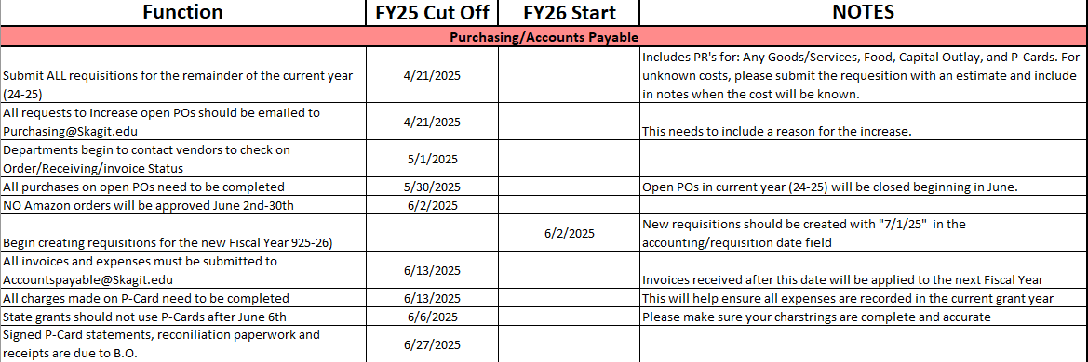
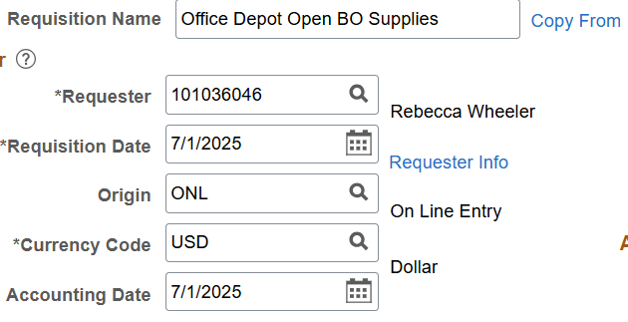
Fiscal Year-End Schedule
Please Note: when creating PR’s for the new fiscal year, enter July 1, 2025 in the
date fields

Slide 12
Helpful Queries
QFS_PO_PO_LINE_DETAIL – Purchase Order History
Type of PO, Status, Supplier, PO Line Total, Remaining Encumbrance, Chartstring, PO
and Requisition #’s
QFS_PO_PO_VCHR_INV_PAY_DETAIL – PO, Requisition, Invoice, Voucher, Payment, Chartstring
Helps you see the process from Requisition through Payment
QFS_PO_PO_WIP_ENCUMBRANCE_ACC – PO’s w/Encumbrance, Distribution Line, Acct
Helps you see the PO with the Encumbrance Balance (Less Detail Line Detail Query)
QFS_PO_CATEGORY_ID_DESCR- PO Category ID’s w/Description
Provides a list of all of the Category ID’s under the Supplies Account 5030010
QFS_PO_REQ_ALL – All Requisitions
Provides all a query that shows all requisitions created
Other Resources
Business Services Webpage (Under Construction) - Business Services - Skagit Valley College
Business Office Portal - Business-Office
Business Office Portal Purchasing Folder - Business-Office

Slide 13
Questions?

