Slide 1

Travel Policies & Procedures
SVC 25-26 Fiscal Year

Slide 2
Where to Find Information
Business Services | Travel
(SVC Public Webpage)
Business-Office
(Staff Portal)
QARS Quick Reference Guide (QRG) | Data Services | ctcLink Reference Center

Slide 3
Contact Information
Miranda Brown
360.416.7646
Travel@skagit.edu
TEAMS
Teresa Miller
360.416.7857
Purchasing@skagit.edu
Teresa.Miller@skagit.edu
Rebecca Wheeler
Associate Director (Miranda/Teresa Supervisor)
Rebecca.Wheeler@skagit.edu
Jamie Betz
Operating Budgets
Jamie.Betz@skagit.edu
Maria Galindo
Grant Budgets
Maria.Galindo@skagit.edu

Slide 4
The policies and procedures mentioned herein are
enforced for all State, Student, and Grant funds
used by Skagit Valley College.

Slide 5
Budgets and Encumbrance
•Chart of Accounts
•Travel Expense Account Descriptions
•Operating Budget Overview – CTCLink Query Cheat Sheet
•Grant Budget Overview – CTCLink Query Cheat Sheet
•Example of Operating and Grant Budget Overview
•Encumbrance: What is it?
•“No Budget Exists”- Email Jamie Betz; Fund 145 email Maria Galindo

Slide 6
responsibility
Business Office
Traveler
Ensure all travel expenditures comply with College and State policies
Ensure that any travel costs incurred are: Directly work related, obtained at the most economical price, and both critical and necessary for state business.
Exercise prudent judgment in approving travel-related costs
Not treat employees differently under like travel circumstances
Pay in a timely manner
Be familiar with state and agency travel and transportation regulations
Collect and submit all appropriate and required documentation
Secure prior authorization for travel when required
Enter expenses in a timely manner
Exercise care when incurring expenses and accomplishing the purposes of the travel
Notes:
BUSOF
Consistently and equally enforce travel expenditure policies to comply with State and College regulations
Pay/reimburse timely
TRAVELER
Follow State and College policies which include but are not limited to:
Receiving required approvals prior to trips,
Collecting and maintaining appropriate and required documentation,
Entering expenses in a timely manner

Slide 7
Process Overview
Identify the trip
Travel Authorization
Approvals
Book Your Accommodations
Cash Advance (Optional)
Attend Trip
Expense Report
Get Reimbursed

Slide 8
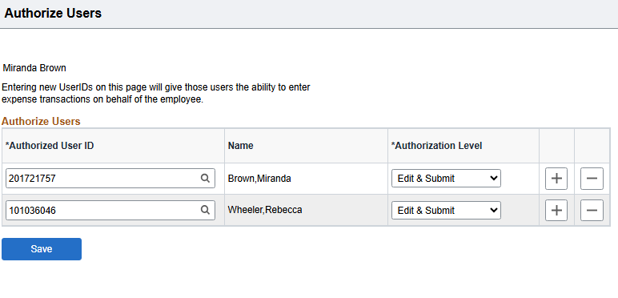
Employee Travel Profile
Getting Started
Menu – Employee Self Service – Travel and Expenses – User Preferences – Delegate Entry Authority
Delegate Authority
Staff can add their own delegates to enter and submit reports on their behalf
Or you can email Miranda

Slide 9
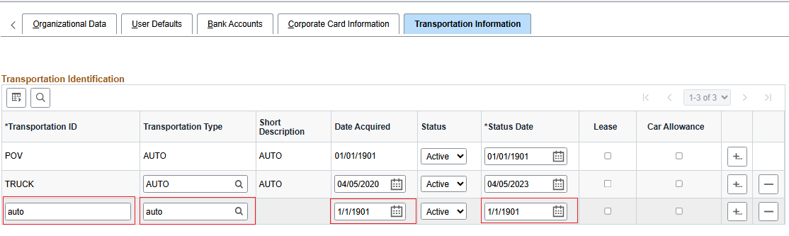
Employee Travel Profile
Menu – Employee Self Service – Travel and Expenses – Review/Edit Profile
Transportation Information
Required to receive mileage

Slide 10
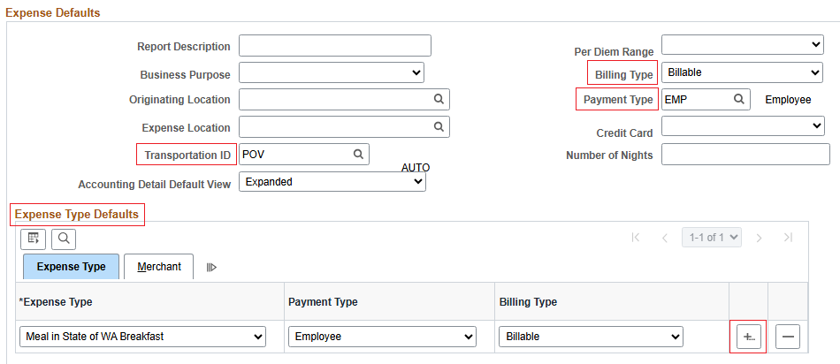
Employee Travel Profile
Menu – Employee Self Service – Travel and Expenses – Review/Edit Profile
Expense Defaults
Makes entering information so much quicker on reports

Slide 11
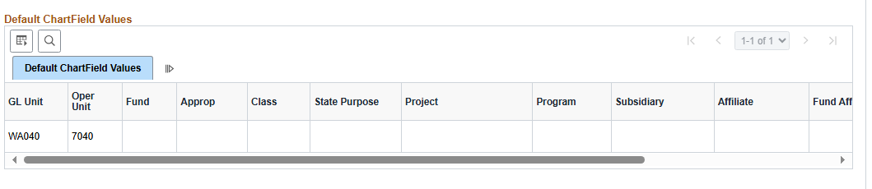
Employee Travel Profile
Contact Miranda
Direct Deposit vs Checks
If you have multiple bank accounts, I will need to confirm which is the correct one.
Accounting Default
Option A – Only Operating Unit and State Purpose
Option B – Chartstring typically always charged towards
Option C – Cash Advance Chartstring

Slide 12
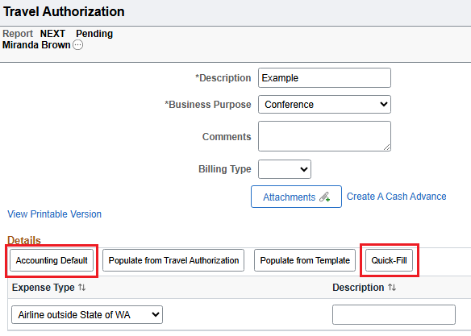
Travel Authorizations
Accounting Default
If you do not have one pre-loaded to your profile or need to change it for the specific report, this is where you enter it.
It will populate to all expense lines entered.
Quick- Fill
This will help save time on entering expense lines.
For example, multiple hotel nights, meals, parking, etc.

Slide 13
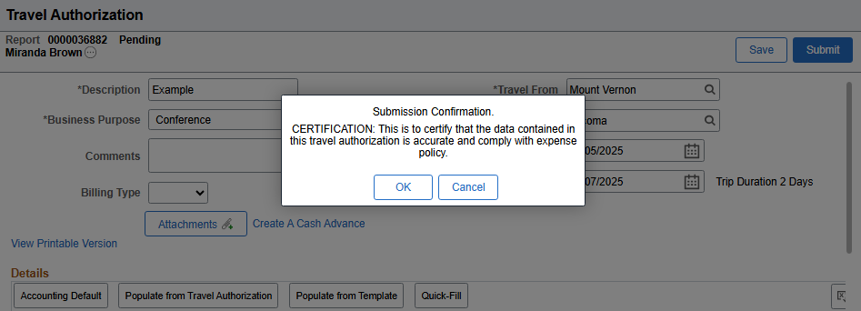
Travel Authorizations
When you attempt to submit your travel authorization, you should see this pop-up!
If not, it means there are errors on your report and it was not submitted.
Look for red flags if this happens or contact Miranda for assistance.

Slide 14
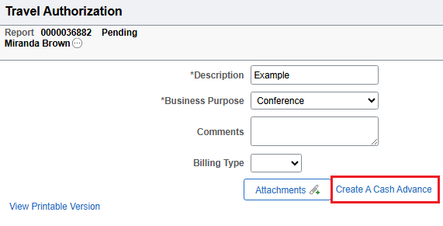
Cash Advances
If you have saved but not submitted your travel auth, you can create a cash advance directly from the TA page.
If you have submitted the travel auth already, you will have to use the navbar: Menu – Employee Self Service – Travel and Expenses – Cash Advance – Create/Modify
*If you receive a cash advance – you are required to fill out an Expense Report to reconcile it.*

Slide 15
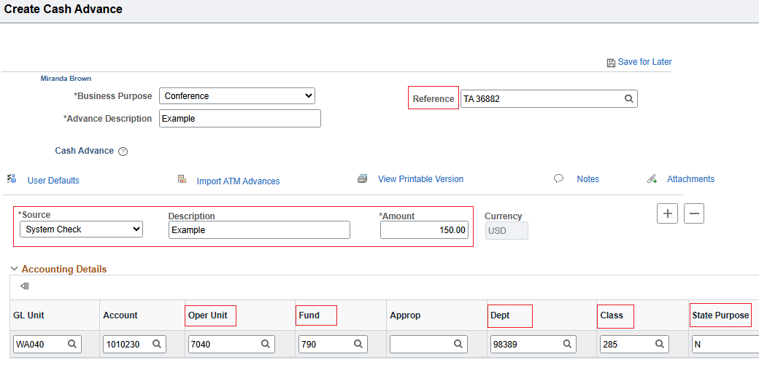
Cash Advances
All Cash Advances are required to use 790-285-98389 budget.

Slide 16



Booking your travel wait for Approvals
How to pay and book travel
Please note:
You should not be booking anything prior to a fully approved Travel Authorization.

Slide 17
How to Pay for Trip
Fees and/or Registration
Lodging
Airfare
Rental Cars
Mileage/Meals
Employee
Department P-Card
B.O P-Card
Employee
B.O P-Card
(CCA Form Required)
Alaska Eazy Biz
OR
B.O P-Card *
Enterprise
B.O P-Card *
Employee

Slide 18

Airfare
Alaska Easy Biz
Other Airlines
Email Teresa or Miranda to be invited
You do not need additional quotes
Our CTA card is the built-in payment option
Attach quote to Travel Authorization*
*Optional but encouraged.
Email receipt to Teresa
Obtain 3 quotes
Take into account price and convenience when choosing
Attach to Travel Authorization
Email Teresa for how to purchase

Slide 19
Important Rules
Out of state and overnight travel costs without a fully approved Travel Authorization may not be reimbursed *
Purchases made on any Department or Business Office P-Card for unapproved travel may be due back to the college at the employee's expense

Slide 20
Traveling with Students
We have created specific travel documents when traveling with multiple students.
Please reach out to me for assistance.

Slide 21
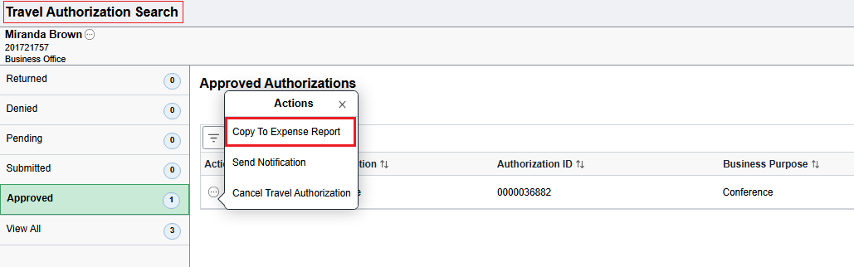
Expense Report
Should be submitted within 60 days upon return
Using the Fluid tile, you'll search for your approved travel auth and copy it to the expense report.
All lines and budgets from the travel auth will be loaded to your expense report.

Slide 22
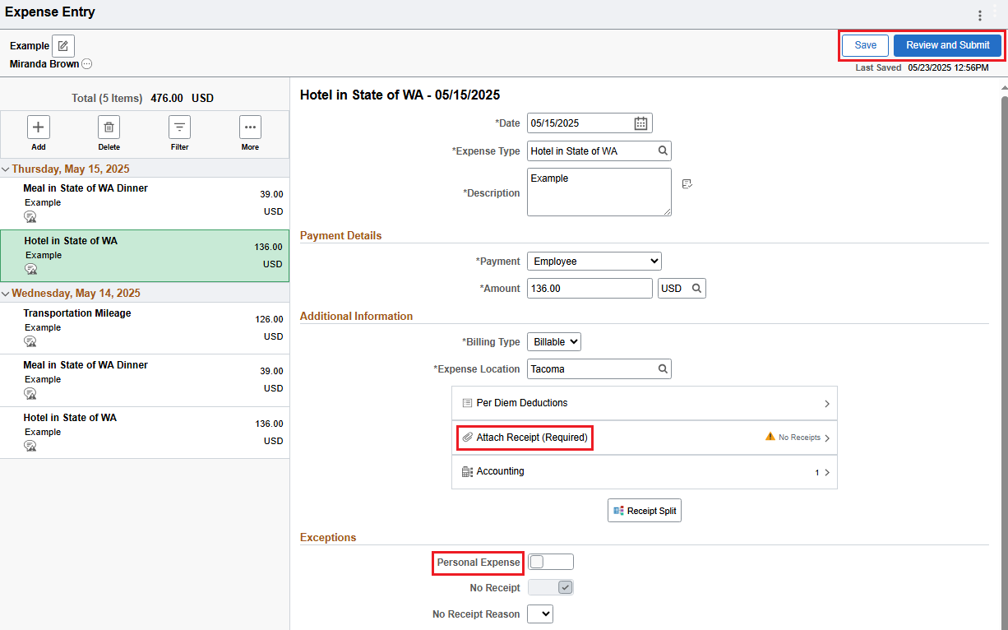
Expense Report
Save first, to help review red flags.
Attach receipts and update totals as needed to lines
"Personal Expense" means non-reimbursable (pcard purchase)
Save again
Review and submit if no red flags/errors

Slide 23
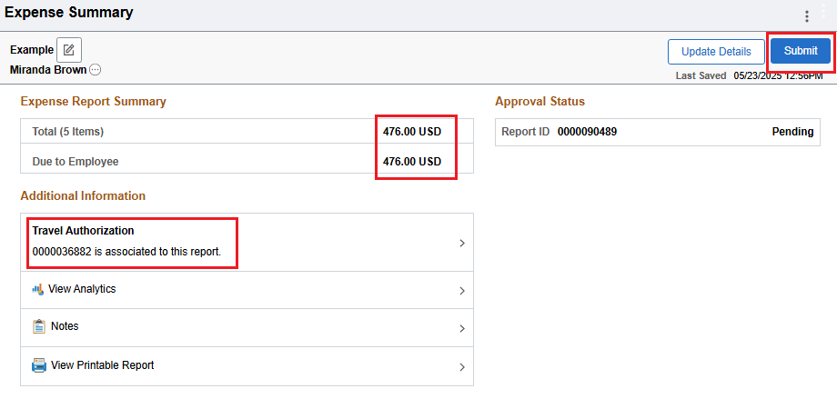
Expense Report
Double check totals.
Ensure TA is associated.
Submit when ready

Slide 24
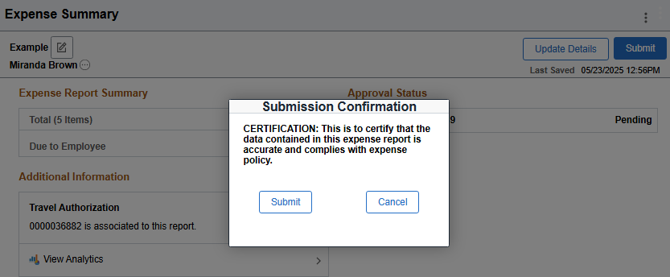
Expense Report
When you attempt to submit your expense report, you should see this pop-up!
If not, it means there are errors on your report and it was not submitted.​
Look for red flags if this happens or contact Miranda for assistance.

Slide 25
Approvals/Errors
If you get a report for someone you either don't oversee and/or are not paying for their expenses from a budget you oversee, email Miranda.
If you receive budget errors while approving, reach out to either Miranda, Jamie or Maria.
Travels auths not approved by month end close will need to be sent back and resubmitted.
Expense reports can have their accounting dates updated and approved in following months.

Slide 26

Comments, concerns, complaints?

Slide 27
Links to Instructions
Travel - Know Before You Go.docx
Travel Authorization Instructions - DRAFT
Expense Report Instructions - DRAFT
Travel - Skagit Valley College

Slide 28
Helpful QRG's
Creating a Travel Authorization - 29a (ctclink.us)
Copying Travel Authorization Expense Lines (ctclink.us)
Submitting Travel Authorizations (ctclink.us)
Creating Cash Advances (ctclink.us)
9.2 Creating Expense Reports From Travel Authorizations (ctclink.us)
9.2 Applying Cash Advances to an Expense Report (ctclink.us)

